Slide 1
Petroleum system (2)
source Rock Evaluation
Maturation of Source Rocks

Slide 2
Maturation of Source Rocks:
Kerogen is composed of large hydrocarbon molecules that are stable at low temperatures, but will break down into smaller molecules of liquid and gaseous hydrocarbon compounds with progressive exposure to higher temperatures. In addition, non hydrocarbon gases such as Co₂ and H₂O are produced, and a nonreactive residue remains. This transformation is controlled by the reaction kinetics and the most important control is temperature (Tissot et al., 1987). Lesser controls are the nature and abundance of the kerogen in the source rock and pressure. Significant oil generation occurs between temperatures approximately 60 and 120ºC, and significant gas generation between 120 and 225ºC, above 225ºC the kerogen is inert, having expelled all hydrocarbons; only carbon remains as graphite (Selley, 1998). The maturation of kerogen can be measured by several techniques as maturation indicators (Fig.below)

Slide 3
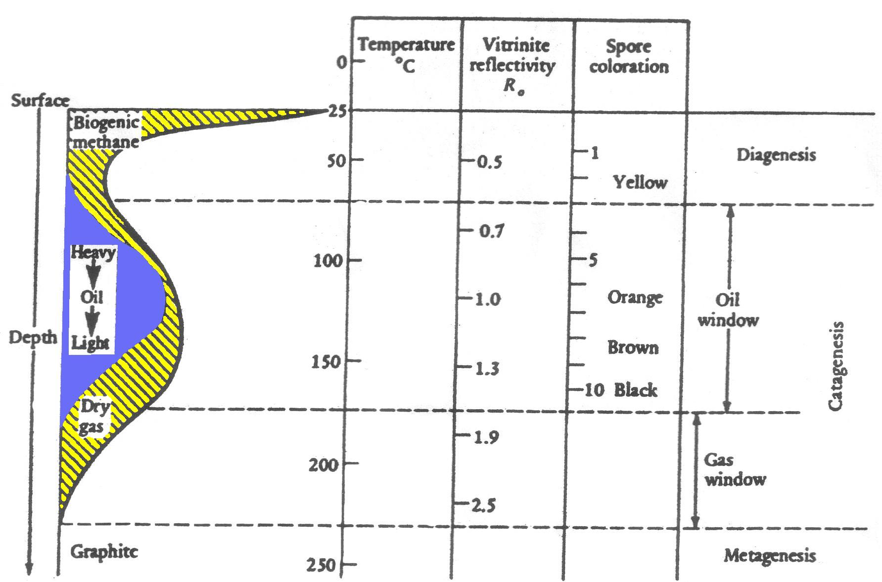

Slide 4
Purposes of Maturation Indicators
• To recognize and evaluate potential source rocks for oil and
gas by measuring their contents in organic carbon and their
thermal maturities
• To correlate oil types with probable source beds through
their geochemical characteristics and the optical properties of
kerogen in the source beds
• To determine the time of hydrocarbon generation, migration
and accumulation
• To estimate the volumes of hydrocarbons generated and
thus to assess possible reserves and losses of hydrocarbons
in the system.

Slide 6
1- Vitrinite Reflectance (R_{o}):
Vitrinite reflectance technique is used to assess the rank of coal samples. Basically, the shininess of coal increases with rank from peat to anthracite. This reflectance can be measured optically. Empirically there is a relationship between vitrinite reflectance and hydrocarbon generation. Crude oil generation occurs for (R_{o}) values between 0.6 and 1.5, gas generation takes place between 1.5 and 3.0; at values above 3.0 the rocks are essentially graphitic and devoid of hydrocarbons (Selley, 1998).
Vitrinite reflectance is the most widely used indicator of thermal stress, because it extends over a longer maturity range than any other indicator. The most fundamental concept in vitrinite reflectance is that a linear increase in temperature causes an exponential increase in reflectance (Hunt, 1996)

Slide 7
R_{o}% in this study is calculated theoretically according to the following equation:
R_{o}= (T_{max}. 0.0180) -7.16 . . . (Jarvie et al., 1991)
• Vitrinite Reflectance (Ro) measures the reflectance of vitrinite (see Kerogen maturation diagram) in oil, expressed as a percentage. It correlates with fixed carbon and ranges between 0.5and 1.3 for the oil window. Laborious but widely used.

Slide 8
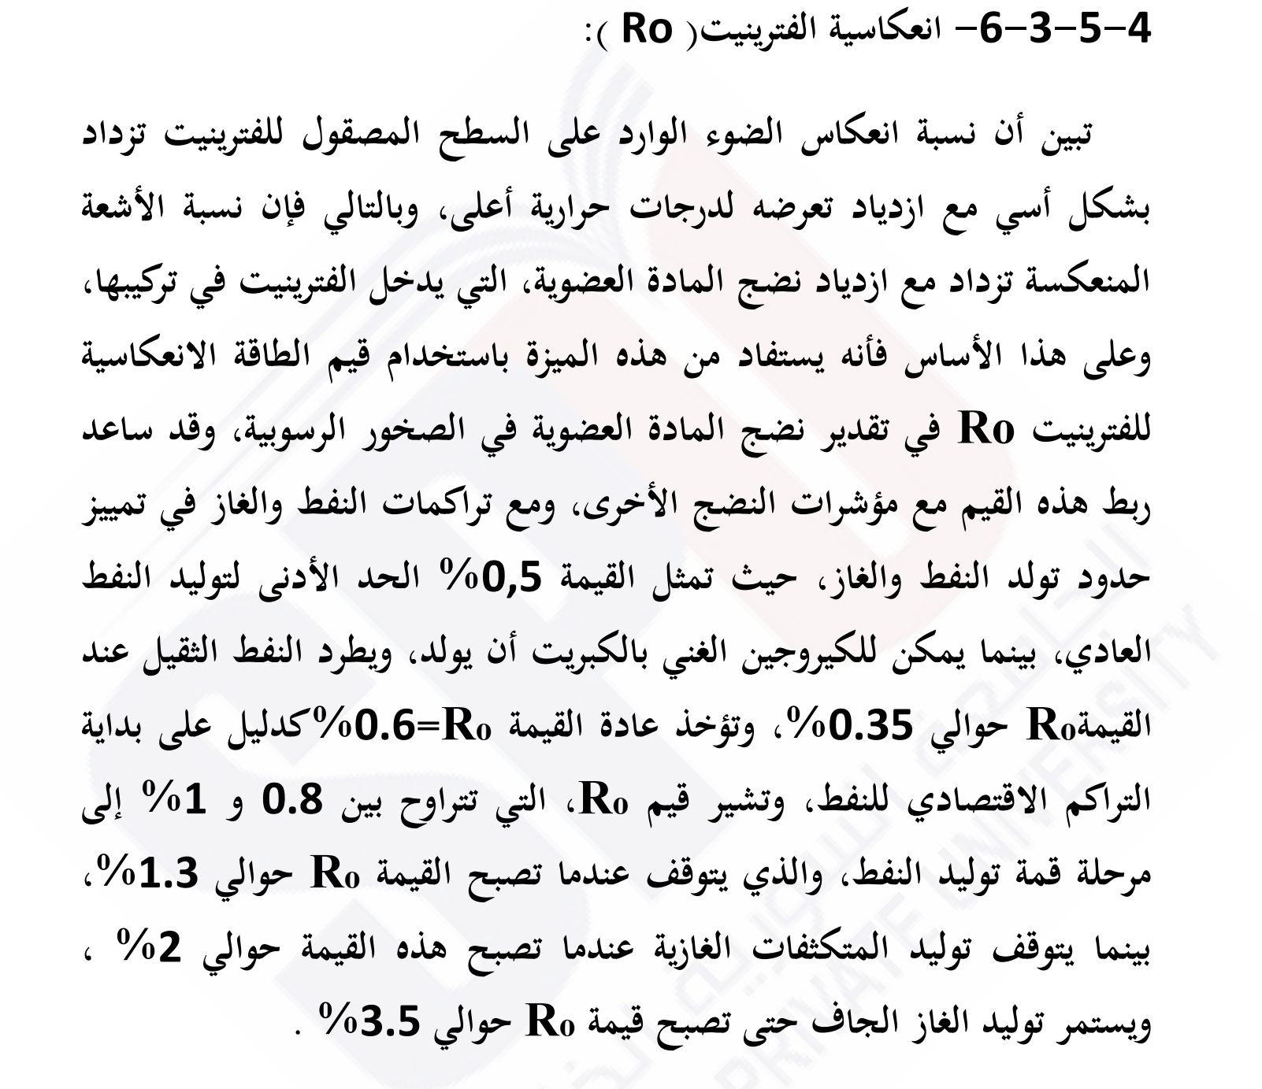

Slide 9
يمكن تحديد السحنات الهيدروكربونية حسب (Urban,1977) بالشكل التالي
درجة النضوج | انعكاس الفترينايت(Ro)
سحنات غير ناضجة | Zero-0.5
سحنات ناضجة | 0.5-1.3
سحنات متحولة | 1.3-2
سحنات شستية | >=2

Slide 11
Comparison of Several Commonly Used Maturity Techniques and Their Correlation to Oil and Gas Generation Limits
0.2
65
1
0.3
70
2
0.4
(C)
0.5
Incipient Oil Generation
75
0.6
3
0.7
80
430
max
0.8
Max. Oil Generated
4
0.9
OIL
Vitrinite Reflectance (R_{o}) %
5
Weight % Carbon in Kerogen
1.0
85
450
Spore Coloration Index (SCI)
1.2
Wet
6
Pyrolysis T
1.3
Gas
7
465
Oil Floor
Dry
90
8
Gas
Max. Dry Gas
9
2.0
Wet Gas Floor
Generated
10
3.0
Dry Gas Floor
4.0
95
(modified from Foster and Beaumont, 1991, after Dow and O’Conner, 1982)

Slide 12
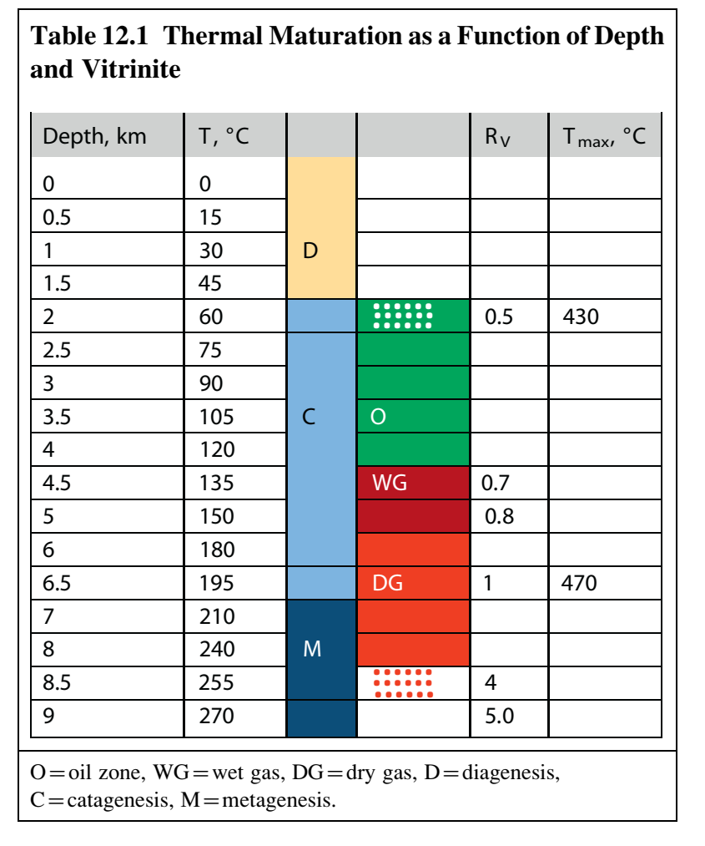

Slide 13
2. T_{max}
T_{max} means a Rock-Eval pyrolysis thermal maturity parameter based on the temperature at which the maximum amount of pyrolyzate (S₂) is generated from the kerogen in a rock sample. The beginning and end of the oil-generative window approximately correspond to T_{max} of 430ºCand 470ºC, respectively(Fig.3-3a and b) (Peters, 1986).
The temperature T_{max} is influenced by the type of organic matter during the diagenetic stage and the beginning of catagenesis. It is lower in the terrestrial kerogen of type III and higher in the marine or lacustrine type I and II. However, the T_{max} values are almost equivalent for the different kerogen types in the peak zone of oil generation and later in the gas zone.

Slide 18
3. Production Index (PI):
Rock-Eval pyrolysis production index (S₁/S₁+S₂) can be used to estimate thermal maturity, Rock-Eval PI value less than 0.1 indicates immature organic matter that generates little or no petroleum.
PI reaches approximately 0.4 at the bottom of the oil window (beginning of the wet gas zone) and can increase to as high as 1.0 when the hydrocarbon-generative capacity of the kerogen has been exhausted (Peters et al., 2005).
PI is meaning less, if the S₂ is below 0.2. Many high PI values above 1mg HC/g TOC indicate migrated oil, especially if the T_{max} decreases and the TOC increases at the same time (Hunt, 1996). Many studies have found that the ratio S₁/S₁+S₂ is fairly independent of the type of organic matter during catagenesis and metagenesis stages (Tissot and Welte, 1984).

Slide 19
Lopatin’s TTI Index
V. Lopatin (1971) recognized the dependence of thermal maturation from temperature AND time. He developed a method where in the temperatures are weighted with the residence time the rock spent at this temperature. Periods of erosion and uplift are also taken into account. This so-called time-temperature index TTI is still in use, although in variations. The plot on the below shows a simple
depiction of it. Rock of age A enters the oil-generating window at time y, while the older rock B has been at that time already in the gas-generating window and will stay there until the present.

Slide 20
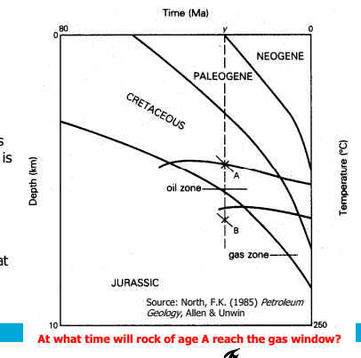

Slide 22
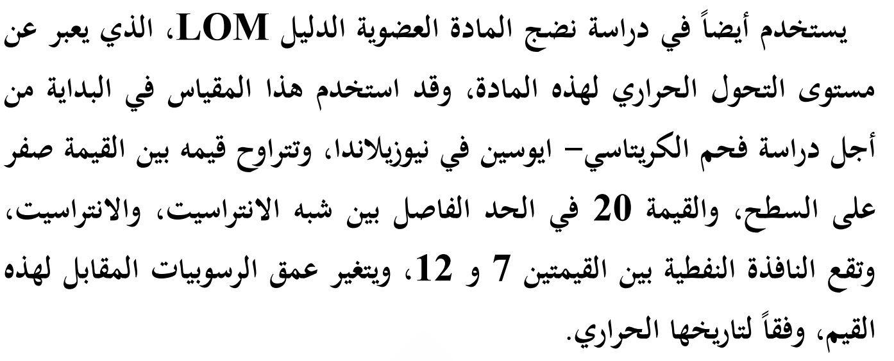
Other Maturation Indicators
Several approaches to quantify the degree of maturation have been proposed aside from the TTI. Most of them are sensitive to temperature and time.
• Thermal Alteration Index (TAI) measures the color of finely dispersed organic matter on a scale from 1 (pale yellow) to 5 (black). This index has a poor sensitivity within the oil window (TAI around 2.5 to 3.0) and is not generally used.
• Level of Organic Maturation (LOM) is based on coal ranks and is adjusted to give a linear scale.

Slide 24
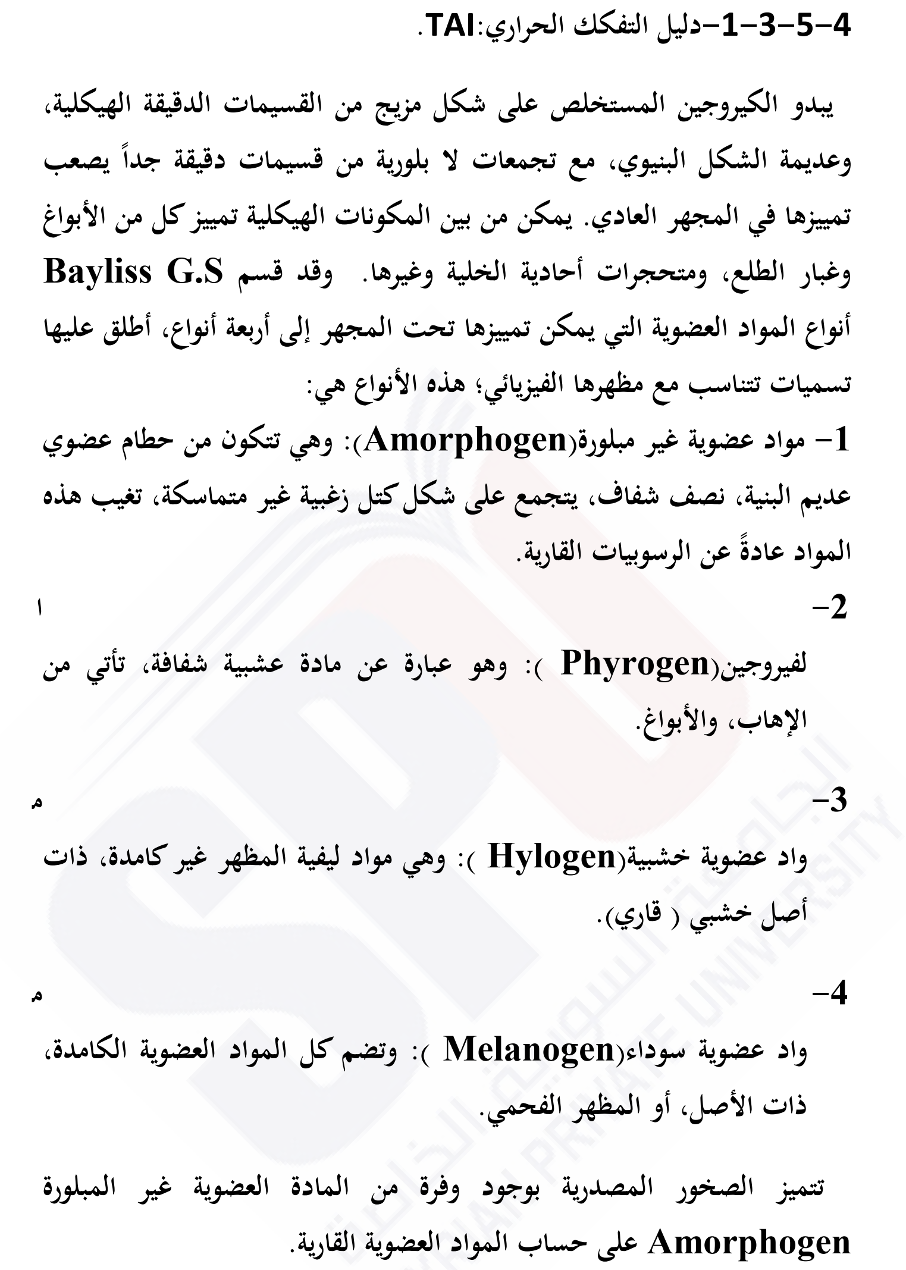

Slide 26
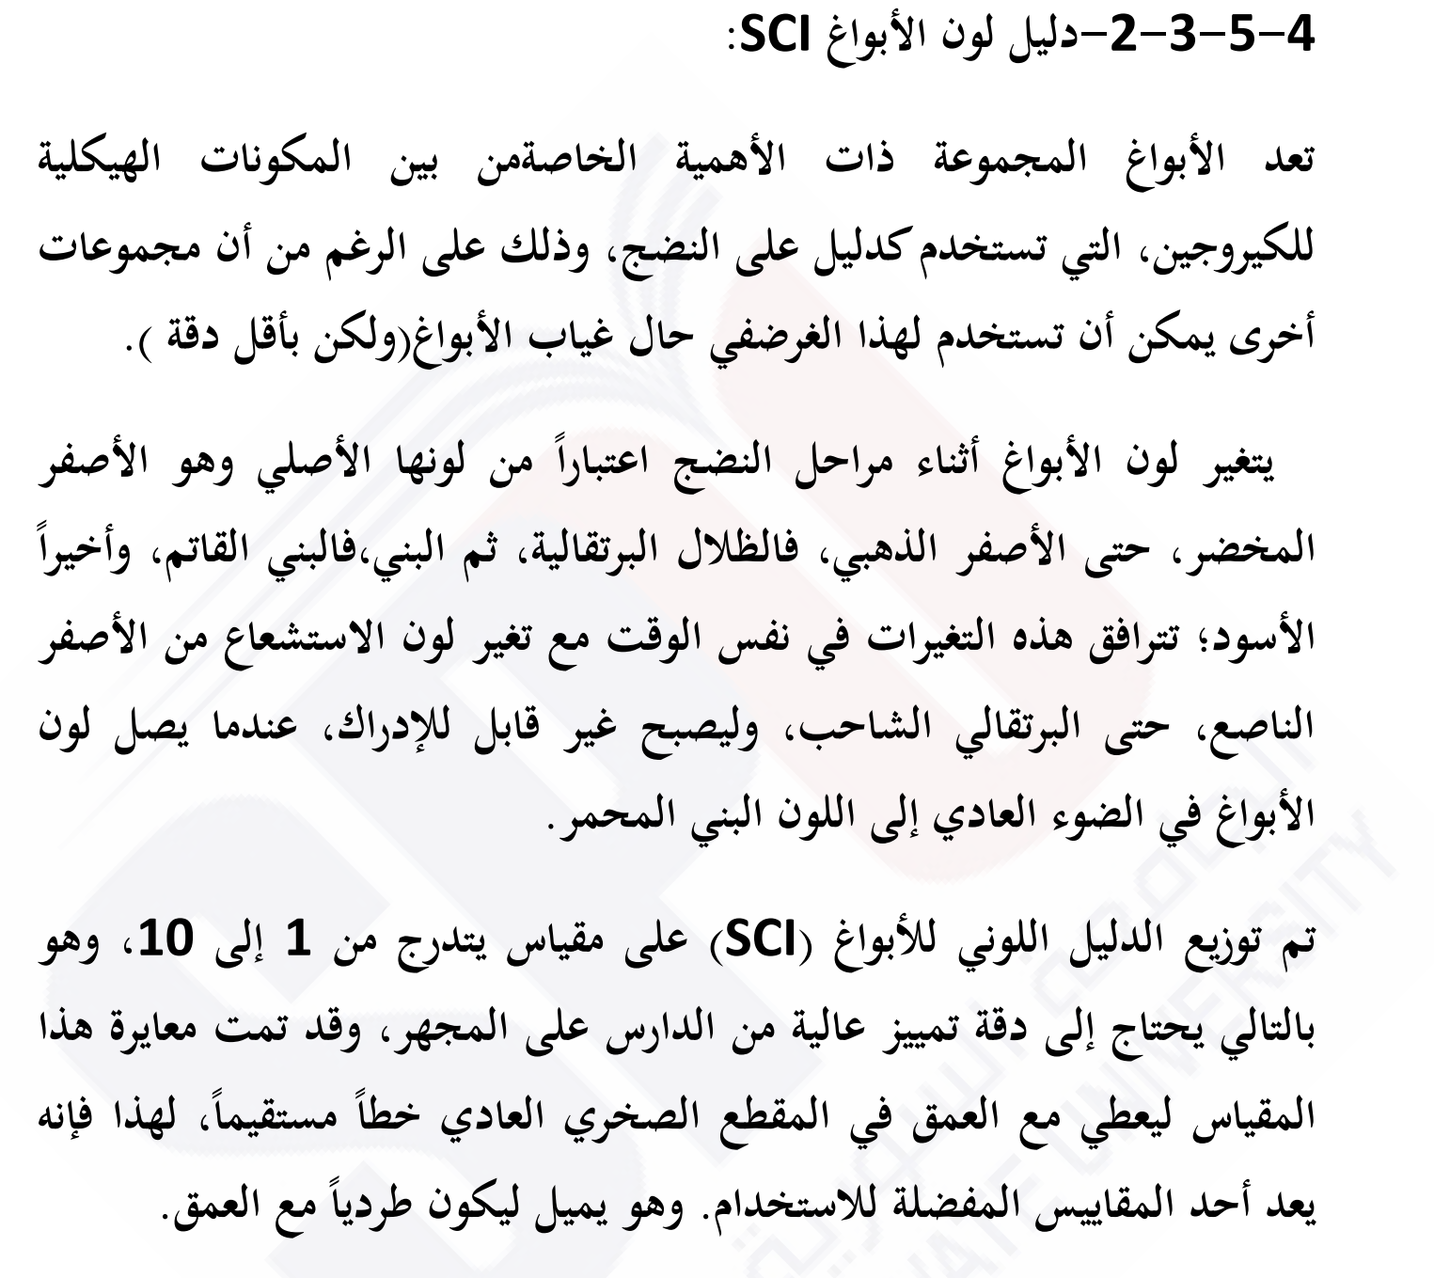

Slide 27
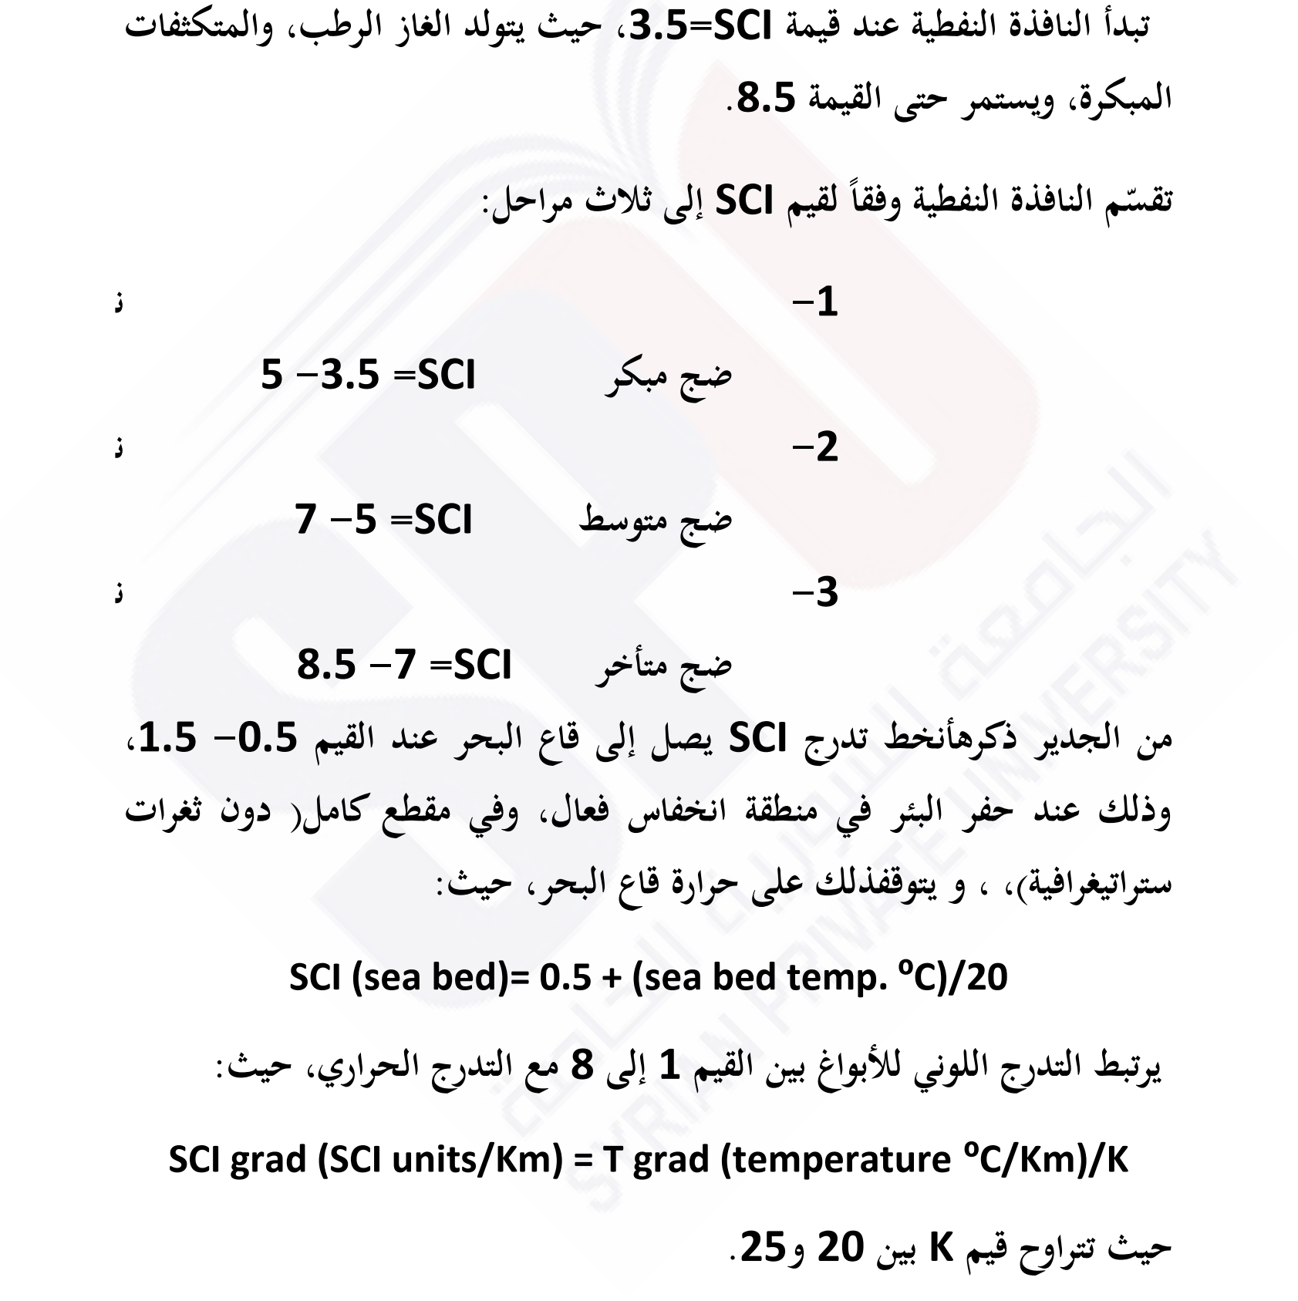

Slide 28
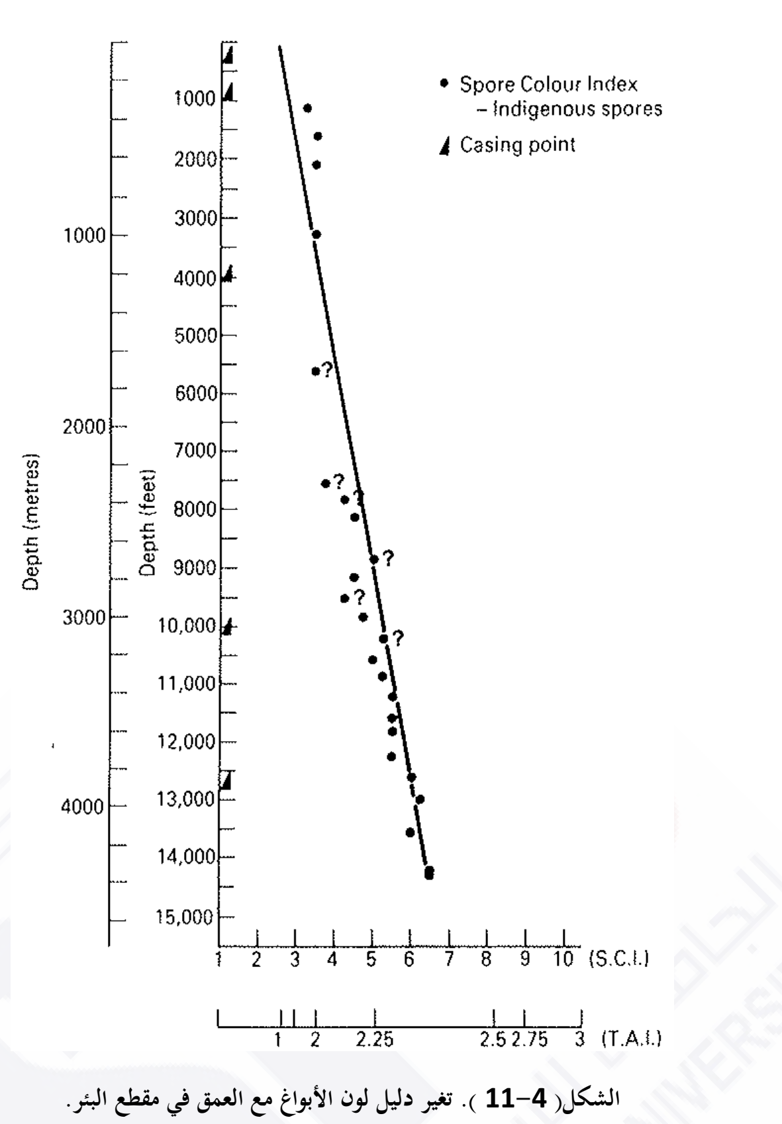

Slide 29
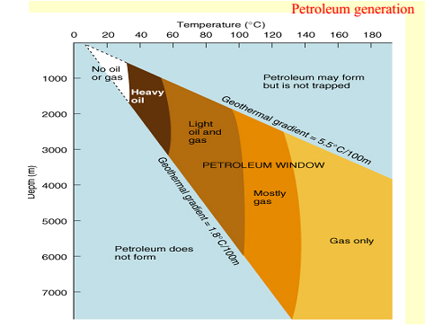

Slide 30
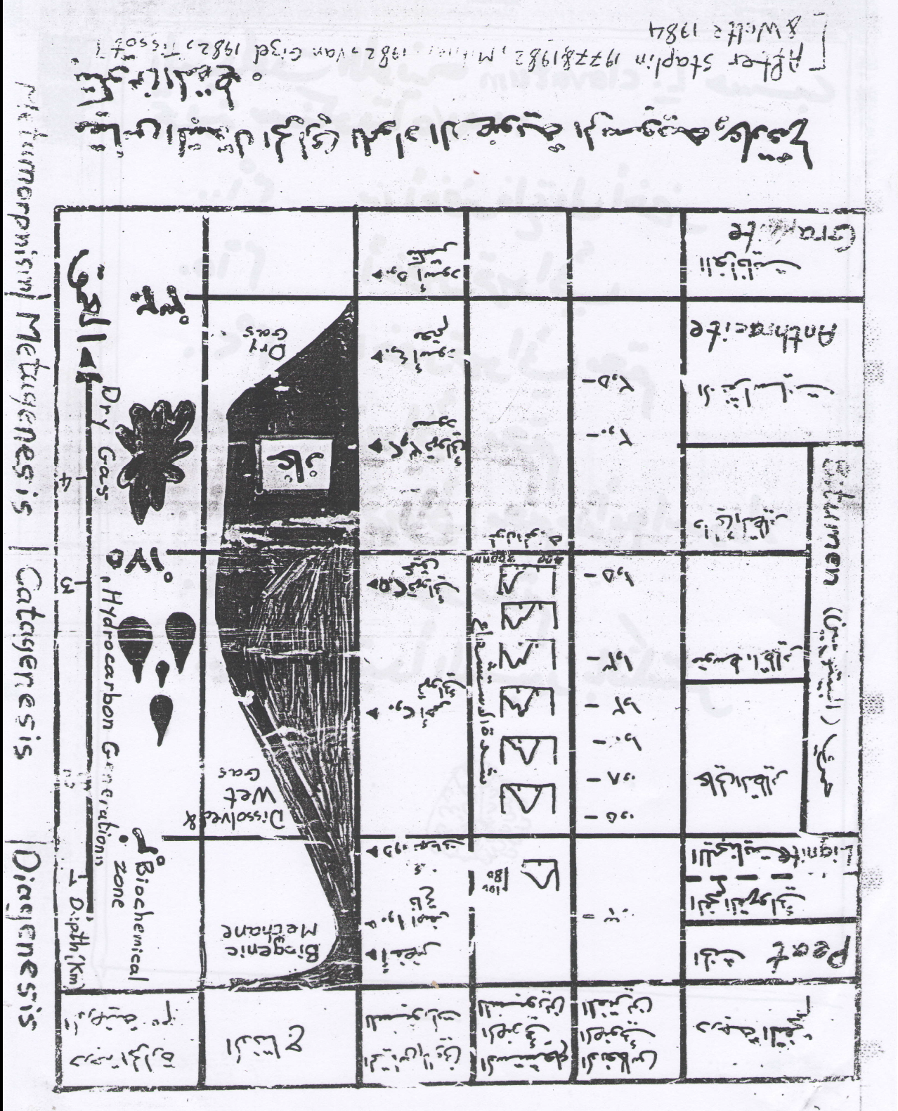

Slide 32
CHART FOR ASSESSMENT OF THERMAL MATURTION FOR SEDIMENARY ORGINIC MATTERS (Basad on Staplin 1969, Van Gijzel 1982, Pearson 1990 & Moo et. al. 1994)
TAI |  |  | VR0 | Fluorescence |  | Organic maturity | Temp. o c | Hydrocarbon generation
Scale | Pollen colour | standard |  | λ max. | Pollen colour
1 | Colourless to light Yellow |  | 0.2 | 580 | Green to Yellowish green | Immature | ͂ 25
1+ | light Yellow |  | 0.3 |  | Yellow |  | 32 | Biogenic methan (marsh gas- diagenetic methan)
2- | Yellow |  | 0.38 |  | Yellow- orange |  | 50
2 | Orange Yellow |  | 0.45 |  | light Orange |  | 65 | First oil formatio (oil birth" zone)
2+ | Dark Yellow |  | 0.61 | 590 | moderate Orange | mature | 90 | peak oil generation
3- | light Yellowish Brown |  | 0.78 |  | Dark Orange |  | 120 | Main phase of oil expulsion
3 | light Brown |  | 0.98 | 660 | Orange- Red |  | 150 | Peak condensate and wet gas generation
3+ | Brown |  | 1.16 |  | Red | Post-mature | 200 | peak dry gas generation (thermogennic methan)
4- | Dark Brown |  | 1.71 |  | No fluorescence |  | 220 | oil floor (oil "death" zone)
4 | Brownish Black |  | 2.58 |  |  |  | 250 | condensate and wet -gas floor
5 | Black & deformed |  | 8.3 |  |  |  | 320 | dry gas preservation limit

Slide 33
تحديد النضوج الحراري
لديك قراءات الانعكاس الضوئي للفترينايت والاستشعاع الضوئي حسب العمق من احد الابار النفطية
المطلوب :
1) التدوين البياني للمعلومات
2) تحديد عمق الاحتمالات النفطية في البئر وماهي الاعمال البحثية الاخرى التي تستكمل بها هذه الاحتمالات
3) اعطاء توقعات حول التاريخ الحراري للطبقاتالرسوبية في هذا البئر
Exinite colour F=Flourescence L=Light microscopy | λmax | VR0 (Reading) | Depth (m)
F=Green L= Yellowish gre | 535 | 0-0.1 (5), 0.1-0.2 (10),0.2-0.3 (20), 0.3-0.4 (10) | 1000
F= Yellowish Green L=Yellow | 550 | 0.1-0.2 (3),0.2-0.3 (5), 0.3-0.4 (18) , 0.4-0.5 (5) | 2000
F=Yellow L=Amber yellow | 560 | 0.2-0.3 (5), 0.3-0.4 (7) , 0.4-0.5 (22), 0.5-0.6 (10), 0.6-0.7(5) | 3000
F= Orange Yellow L=Brownish yellow | 580 | 0.6-0.7 (5), 0.7-0.8 (15) , 0.8-0.9 (10) | 3500
F=Orange L=Brown | 590 | 0.7-0.8 (10), 0.8-0.9 (20) , 0.9-1 (5) | 4000
F=Red L=Redish brown | 610 | 0.8-0.9 (10), 0.9-1 (15) , 1-1.1 (25), 1.1-1.2 (10) | 4500

Slide 34
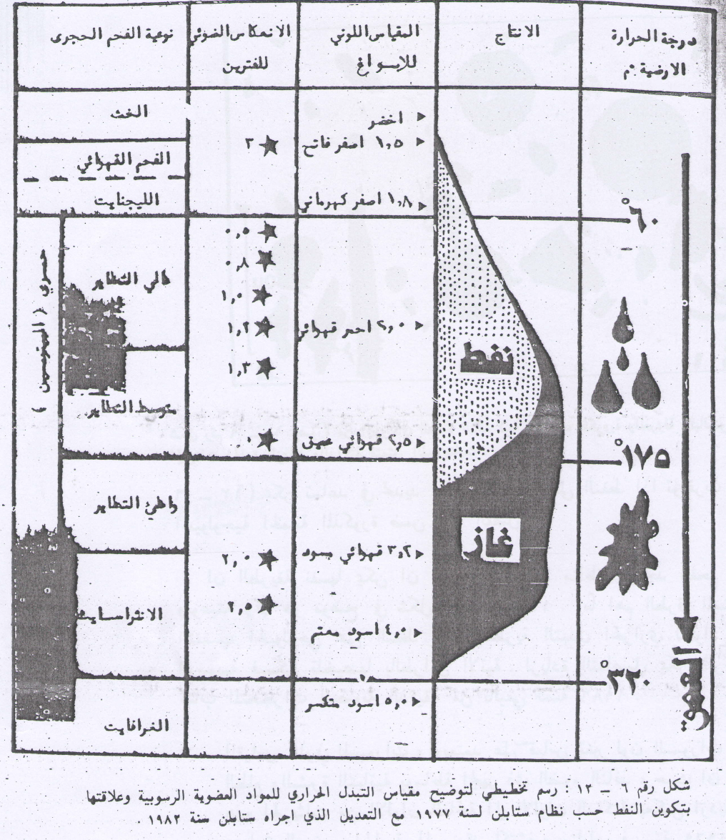

Slide 35
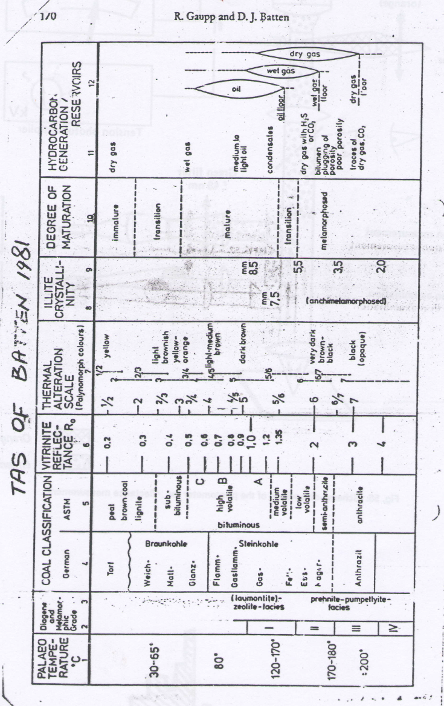

Slide 36
Kerogen Type | Form | Hydrocarbone Generation | Temp.(˚C) | Orga. Matur. |  | Flour. |  | T.A.I. |  | V.R. | Logs Response |  |  |  | Depth(m) | Source RX
 |  |  |  |  |  | Poll. Col | λ max | Poll.Col. | Sc. |  | ∆T | ρ | R. | GR
I | Weak |  | ≈25 | Immatur. |  | G.-Y.G. | 580 | C.less | 1 | 0.2 | hi | hi | hi | hi | 400
III | Good | BioDegra.(Biogenic Methan)Marshes Methan | 32 |  |  | Y. |  | L.Y. | 1⁺ | 0.3 | lo | lo | hi | hi | 800 | *
II | Moder. |  | 50 |  |  | Y.O. |  | Y. | 2⁻ | 0.38 | lo | hi | hi | lo | 1200
I | Weak | Firset Oil Formation(Oil brith Zone) | 65 |  |  | L.O. |  | O.Y. | 2 | 0.45 | lo | lo | lo | lo | 1600
II | Moder. | Peak Oil generation | 90 | Matur. |  | M.O. | 590 | D.Y. | 2⁺ | 0.61 | lo | lo | hi | hi | 2000 | *
III | Good | Main phase of Oil expulsion | 120 |  |  | D.O. |  | L.Y.B. | 3⁻ | 0.78 | lo | hi | lo | hi | 2400
I | Weak | Peak condensate and wet gas generation | 150 |  |  | O.R. |  | L.B. | 3 | 0.98 | hi | lo | hi | lo | 2800
III | Good | Peak dry gas generation(thermogenic methan) | 200 | Postmatur. |  | R. | 660 | B. | 3⁺ | 1.16 | lo | lo | hi | hi | 3200 | *
III | Good | Oil floor(Oil death zone) | 220 |  |  | No Flour. |  | D.B. | 4⁻ | 1.71 | hi | lo | lo | hi | 3600
II | Moder. | Condensate and wet gas floor | 250 |  |  |  |  | B.D | 4 | 2.58 | lo | lo | hi | hi | 4000 | *
III | Good | Dry gas floor | ≈300 |  |  |  |  | B. | 4⁺ | ≈5 | hi | hi | hi | hi | 4400
IV | V.Good | Dry gas preservation limit | 320 |  |  |  |  | B.Def. | 5⁻ | 8.3 | lo | lo | hi | hi | 4800 | *

Slide 44
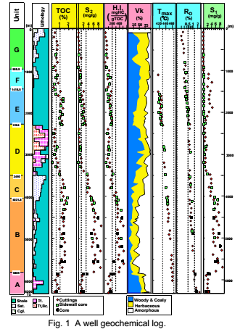

Slide 45
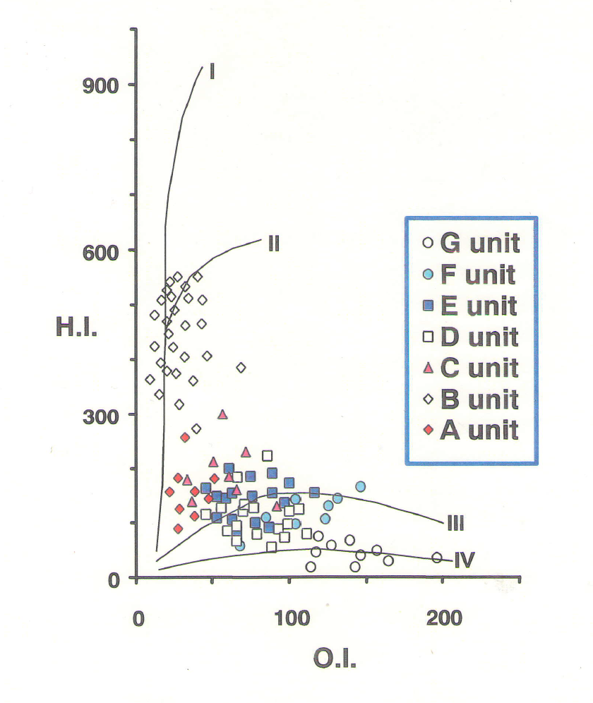

Slide 46
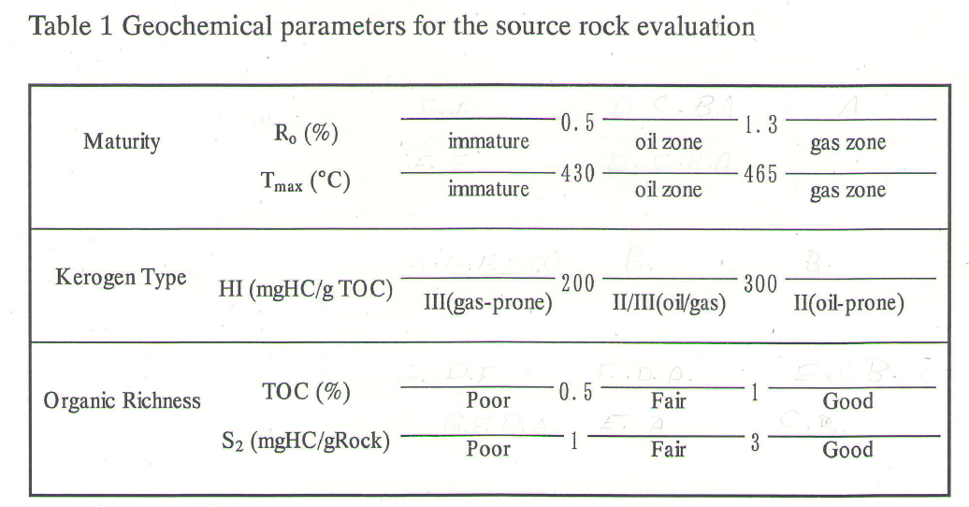

Slide 48
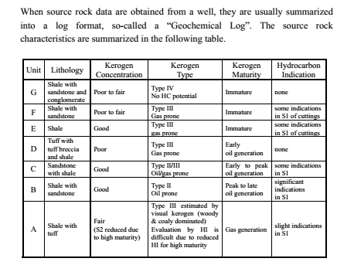

Slide 49
